Slide 1
Module 2: Diagnosis

Slide 2
Learning objectives
Screen children and adolescents to identify presumptive TB
Identify key components of the clinical evaluation
Have a systematic approach to the diagnosis
Use diagnostic tests as indicated to diagnose TB
Notes:
This module will focus on identification and assessment of children and adolescents who have symptoms or signs that could be caused by TB.
At the end of this module, participants will be able to:
Conduct TB screening to identify children and adolescents with TB or at risk for TB
Identify key components of the physical exam when evaluating a child or adolescent for TB
Identify children and adolescents who require further evaluation for TB and know the approach to diagnosis
Use diagnostic tests as indicated to diagnose TB

Slide 3
Outline
Introduction and principles of diagnosis
Clinical presentation and assessment
Laboratory investigations
Chest X-ray
Treatment decision approaches
Case study quiz
Conclusion
Challenge your knowledge
Notes:
This is the outline of what we will cover in this module.
We start with an introduction and cover the principles of TB diagnosis in children and adolescents.
We will then proceed with the presentation following the usual approach to evaluation of a child and adolescent with presumptive TB, starting with clinical assessment, evaluating for bacteriological confirmation whenever possible, highlighting the important supportive diagnostic role of chest X-ray and finishing with the decision to treat or not to treat for TB.
Towards the end, there will be a case study quiz.
We’ll conclude the module with a summary of key points for you to take away.

Slide 4
Outline
Discussion
Introduction and principles of diagnosis
Clinical presentation and assessment
Laboratory investigations
Chest X-ray
Treatment decision approaches
Case study quiz
Conclusion
Challenge your knowledge
Discussion
Notes:
There will also be a couple of opportunities to share some of your own country specific setting practices in small groups.

Slide 5


Discussion – setting specific practices
Note to facilitator:
Suggested instructions:
These context specific discussion opportunities will occur repeatedly throughout this training. Here are some suggestions on how you might like to facilitate them, to run them in a time efficient manner.
Explain that the next 15 minutes will be devoted to sharing amongst your colleagues, about how things may work in your setting.
Explain that 3, or 4, questions will be shown on the presentation.
Then divide the questions amongst the groups. Some groups may need to discuss the same question.
Tell them they will have just 2 or 3 minutes to discuss in their small groups. Then you will discuss as a large group.
Allow 2-3 minute discussion time.
When this time is up, ask for everyone’s attention. And then ask for volunteers to comment on each question discussed. Request participants to keep their responses succinct so that the time allows for others to also contribute.
Acknowledge all responses and thank participants for sharing.
Be mindful of the time and try to wrap up discussions so that the full activity takes no more than 15 minutes.
Click for audible instructions
To discuss Question 1
To discuss Question 4
To discuss Question 2
To discuss Question 3
Notes:
These context specific discussion opportunities will occur repeatedly throughout this training.
Here are some suggestions on how you might like to facilitate them, to run them in a time efficient manner.
Explain that the next 15 minutes will be devoted to sharing amongst your colleagues, about how things may work in your setting.
Explain that 3, or 4, questions will be shown on the presentation.
Then divide the questions amongst the groups. Some groups may need to discuss the same question.
Tell them they will have just 2 or 3 minutes to discuss in their small groups. Then you will discuss as a large group.
When this time is up, ask for everyone’s attention. And then ask for volunteers to comment on each question discussed. Request participants to keep their responses succinct so that the time allows for others to also contribute.
Acknowledge all responses and thank participants for sharing.
Be mindful of the time and try to wrap up discussions so that the full activity takes no more than 15 minutes.

Slide 6
Discussion: setting specific practices
How are children and adolescents identified as having presumptive TB at your health facility?
1
What is your usual approach to diagnosis, and do you use a guide for a diagnostic approach?
2
What TB diagnostic tests are available at your health facility and what samples do you routinely collect?
3

Slide 7
How are children and adolescents identified as having presumptive TB at your health facility?
1
What is your usual approach to diagnosis, and do you use a guide to diagnostic approach?
2
What TB diagnostic tests are available at your health facility and what samples do you routinely collect?
3

Slide 8
Introduction and principles of diagnosis

Slide 9
TB disease classification
Pulmonary TB (PTB): involves lungs and intrathoracic lymph nodes
Extra-pulmonary TB (EPTB): involves sites beyond the lungs and intrathoracic lymph nodes. Children with EPTB often have PTB as well.
Bacteriologically confirmed: positive sample by approved diagnostics such as Xpert Ultra
Clinically diagnosed: a decision is made to treat but TB is not confirmed bacteriologically
Notes:
TB disease that involves the lungs is called pulmonary TB and in children especially, enlargement of the draining intrathoracic lymph nodes is a common manifestation whereas in adolescents, the pathology is more similar to adults such as with cavities.
Extra-pulmonary TB refers to TB of any site other than the lungs and intrathoracic lymph nodes – common sites being lymph nodes in the neck, pleural TB or disseminated TB such as TB meningitis and miliary TB.
Until recently, TB that presented with enlargement of the intrathoracic lymph nodes – that is hilar or mediastinal lymphadenopathy – was often classified as extra-pulmonary TB but it is now more correctly notified and reported as pulmonary TB as the lymph node enlargement is a response to infection in the lungs.
Note that it is not unusual for a child to have TB that involves both pulmonary and extra-pulmonary sites – this is notified and reported as pulmonary TB
Both pulmonary and extra-pulmonary TB is either bacteriologically confirmed or not, and if not is referred to as clinically diagnosed.
Bacteriologically confirmed is when a sample is positive for Mtb by approved diagnostics such as Xpert (Ultra); smear microscopy, culture, urinary LAM etc;
Clinically diagnosed is all the others when a decision to treat for TB has been made without bacteriological confirmation because the test was negative or a sample was not tested/taken

Slide 10
Introduction
Children and adolescents with TB usually present to MCH services as an outpatient.
Improving detection of presumptive TB requires strengthening capacity at the different levels of care with increasing awareness to screen for TB.
The capacity of HCWs to proceed to diagnosis and treatment depends on clinical and laboratory diagnostic capacity.
Notes:
Children and adolescents with or at-risk for TB present to different care entry points such as outpatient, maternal and child healthcare services rather than directly to specialized TB clinics or for inpatient care
It is important to strengthen capacity of the health care workers at the different entry points or levels of care by increasing awareness to screen for TB. Presumptive TB is a person who presents with symptoms and signs suggestive of TB, i.e. TB is a possible or “suspected” cause of their illness
HCWs need the confidence to undertake clinical assessment and proceed to diagnosis and treatment or referral. The approach to diagnosis and treatment decision relies on clinical diagnostic capacity, which includes access to radiology, as well as laboratory diagnostic capacity.

Slide 11
Principles of diagnosis in children
HIGH BURDEN SETTINGS
Screening for TB should be routine in the evaluation of a sick child.
A child who presents with symptoms or signs of TB is referred to as having presumptive TB and should undergo further evaluation.
Seek bacteriological confirmation whenever possible but a negative laboratory test does not exclude TB.
Children with TB often have paucibacillary* disease and clinical diagnosis is commonly required.
Diagnosis can be made with confidence in the majority of children using careful clinical assessment, with or without chest x-ray.
*Paucibacillary – meaning having few bacilli.
Notes:
It is commonly stated that the diagnosis of TB in a child is always “difficult”. This is not helpful or even always true.
It certainly can be difficult to get bacteriological confirmation in most children. However, TB diagnosis can be made with confidence in the majority of children using careful clinical assessment. And a critical role of training is to improve and support the confidence of healthcare workers to be able to diagnose a child with TB.
In high burden settings, children who present to the different care entry points should be routinely screened for symptoms or signs of TB. A child in whom TB is a possible or “suspected” cause of their illness because they present with TB-related symptoms and signs is referred to as having presumptive TB and should undergo further evaluation
We should try for bacteriological confirmation whenever possible. However, TB in young children is usually primary pulmonary and paucibacillary (few bacilli), sputum can be difficult to obtain and a negative laboratory test does not exclude TB

Slide 12
Principles of diagnosis in adolescents
HIGH BURDEN SETTINGS
Screening for TB should be routine in the evaluation of a sick adolescent in a TB endemic setting.
An adolescent with presumptive TB should undergo further evaluation as per the national guidelines.
The diagnosis of TB in adolescents follows the same principles as that of adults.
Bacteriological confirmation is commonly achieved.
Notes:
Adolescents (10-19 years) who present to different care entry points should also be routinely screened for symptoms and signs of TB
An adolescent with presumptive TB should undergo further evaluation as per the national guidelines
TB diagnosis in adolescents follows the same principles as that of adults and the pattern of disease is similar to that of adults, including cavities on CXR for pulmonary TB
Approach to diagnosis is similar with regards to sputum collection and examination and bacteriological confirmed TB is common especially in older adolescents (15-19 years)

Slide 13
Principles for drug-resistant TB diagnosis in children
Approach to diagnosis of drug-resistant TB is similar to that for drug-susceptible TB.
A high level of clinical suspicion is needed for timely diagnosis.
Seek to determine if there has been exposure to drug-resistant TB.
The diagnosis is usually clinical but always obtain a sample for bacteriological confirmation with drug resistance such as Xpert Ultra.
If contact with DR TB, determine drug-susceptibility result and current treatment for that index case.
Notes:
The clinical presentation and approach to the diagnosis of MDR/RR TB in children is similar to that for drug-susceptible TB
A high level of clinical suspicion is needed for timely diagnosis so assess for risk factors, especially recent exposure to someone with known MDR TB or who is having a poor response to first-line treatment
As with drug-susceptible TB, the diagnosis of MDR TB in children is usually clinical with CXR but always seek bacteriological confirmation with a test for drug resistance such as by Xpert and suitable samples are as for other forms of TB diagnosis
If there is known contact with an index case with MDR TB, determine which drugs the index case’s TB is resistant to and which drugs they are being treated with.

Slide 14

Diagnosis of tuberculosis in children and adolescents
Clinical history
Contact
history
Clinical
exam
Other imaging
TST or IGRA
CXR
Micro-biology
Course of antibiotics and review
Refer
(if available)
H. Simon Schaaf, Ben J. Marais, Isabel Carvalho, James A. Seddon. Challenges in childhood tuberculosis. Eur Respir Monogr 2018; 82: 234-262
Notes:
There are many aspects of diagnosing tuberculosis in children and adolescents that fit together to create a bigger picture: clinical history, history of contact living with TB, findings on clinical examination as well as various investigations looking at exposure, radiology and other imaging, laboratory investigations and exclusion of other differentials need to be taken into account.

Slide 15
Clinical presentation and assessment

Slide 16
Screening or assessing for presumptive TB
Ask about symptoms and history of contact with a person with TB:
Common TB-related symptoms in all ages are:
  Cough
  Fever
  Weight loss, poor weight gain or failure to thrive
  Fatigue or reduced playfulness or activity
  Night sweats or haemoptysis possible, especially in older ages
Recent close/household contact with a person with TB should trigger assessment for TB
The presence of any one of these symptoms, or exposure to a person with TB, is considered a positive screen and should prompt further evaluation.
Presentation may be acute in young children.
Notes:
The commonest symptoms noted in a child or adolescent TB are listed, and the patient may have one or more of these symptoms. We think of TB when the symptoms such as cough are persistent – meaning for two weeks or more – and when not improving. However, symptoms may also be acute especially in infants when disease progression can be more rapid. Children with TB do not thrive and so carefully assess for evidence of weight loss or failure to gain expected weight. Older children and adolescents may report night sweats or even haemoptysis.
The common symptoms are not very specific to help distinguish from other common diseases of childhood in TB endemic settings. So important always to think of TB and seek a history of recent contact with either someone known to have TB or someone who has symptoms of presumptive TB.

Slide 17
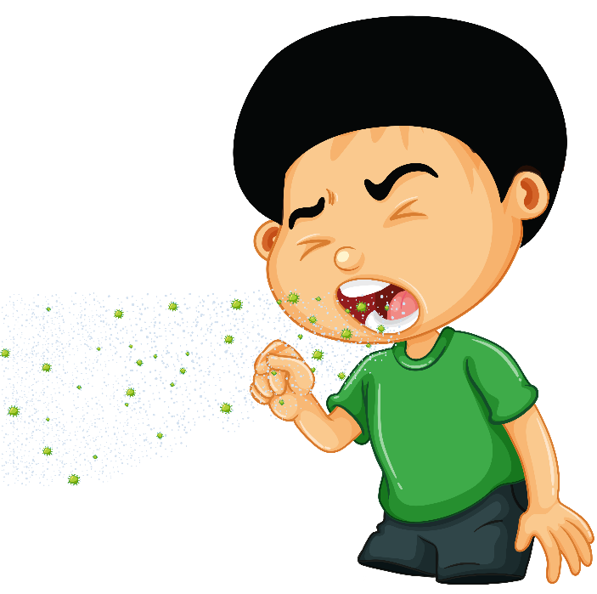
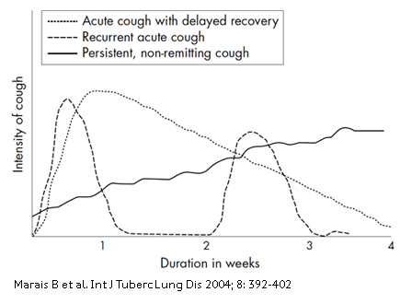
Cough pattern
Intensity of cough
Duration in weeks
Marais BJ, Gie RP, Schaaf HS. The natural history of childhood intra-thoracic tuberculosis: a critical review of literature from the pre-chemotherapy era. Int J Tuberc Lung Dis. 2004 Apr;8(4):392-402. PMID: 15141729.
Notes:
TB commonly presents with persistent, non-remitting cough, including not improved following appropriate management such as for pneumonia, fever or malnutrition. The cough pattern is different to that which may occur with common self-limiting upper or lower respiratory tract infections such as due to viruses that may persist but usually start to improve after a couple of days and with onset often associated with other upper respiratory symptoms such as nasal discharge.

Slide 18


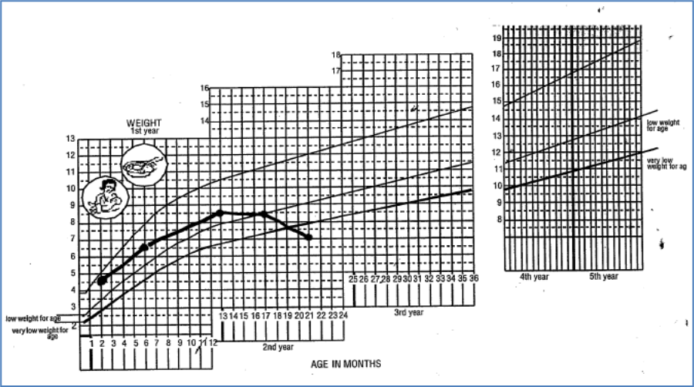



TB evaluation
DOB
BCG
Age
BCG status
Recent TB contact
  Contact may occur be within the home or outside the home
  Contact may be in contact with TB case not yet diagnosed
  Type of TB in source case, including drug resistance, can inform evaluation and treatment
Weight – with comparison to previous weights
Comorbidities that increase risk of TB and mortality
  HIV infection
  Malnutrition
  Diabetes
Notes:
Once we have assessed the clinical presentation and consider TB as a possible diagnosis, our evaluation should include assessment of the risks for TB infection or disease.
Young age is an important risk for disease following infection and for severe, disseminated disease, as is a lack of BCG immunization.
Determining if there has been recent exposure to TB is critical. There may be a known contact within the home or outside the home, or with someone who is as yet not diagnosed with TB - and therefore history of contact with a person who has chronic cough is important. If there is a contact, then we will want to know features of the index case such as relationship to child, type of TB, whether drug-susceptible or resistant, whether being treated and improving with treatment etc.
Routinely check weight and compare to any previous recorded weights. TB is common in children with severe malnutrition and always check HIV status

Slide 19
Perform clinical examination
Key components include:
General observations
  Measure temperature and count respiratory rate.
  Observe breathing difficulty.
  Assess for severity of condition, noting presence of any danger signs – to indicate need for inpatient care or referral.
Growth assessment
  Evidence of weight loss, poor weight gain or failure to thrive
  Check weight and compare with previous weights.
  Measure the mid-upper arm circumference (MUAC).
Specific clinical abnormalities depending on site of symptoms for presumed EPTB
  Check for neck swelling.
  Ask about abdominal pain.
Notes:
Key components of the physical exam are as for any sick child or adolescent.
General observations as to how sick or severely ill the patient is, include: checking vital signs such as temperature and respiratory rate while noting if there are danger signs that indicate the need for immediate inpatient care and management such as severe respiratory distress or reduced consciousness – the same as the IMCI or ETAT approach
Always assess for any objective evidence of weight loss or failure to thrive utilising the Road to health book if available and assess for severe acute malnutrition. TB is an important cause of severe malnutrition.
Further examination may be directed by site of symptoms such as neck swelling or abdominal pain.

Slide 20
Physical examination for TB
Exam findings in pulmonary TB
  Chest examination may be normal
  Abnormal +/- added sounds (crackles)
  Dullness to percussion (pleural fluid)
Atypical presentation of PTB
  Acute pneumonia in infants and HIV–infected children.
  Asymmetrical wheeze that is not responsive to bronchodilator therapy
Alternative causes of chronic or persistent respiratory symptoms include bronchiectasis which is associated with finger clubbing
EPTB: findings depend on site of presentation e.g. cervical lymph node TB, Tb pleural effusion, miliary TB, spinal TB, abdominal TB, or pericardial TB
Notes:
Check for clinical signs that are consistent with PTB. Chest examination is often normal with normal breath sounds and no focal abnormalities.
Or there may be focal abnormalities on auscultation or dullness to percussion suggesting pleural fluid.
Note that TB can present as acute severe pneumonia with chest indrawing and focal abnormalities – either as primary TB disease or as secondary bacterial pneumonia on the background of lung disease due to TB. This presentation is most common in infants and HIV–infected children. Wheeze can occur due to compression of large airways due to enlarged lymph nodes – unlike asthma, TB-related wheeze is usually more unilateral is not responsive to bronchodilator therapy.
Some disease conditions, for example bronchiectasis present like PTB with persistent, recurrent cough. Finger clubbing is a marker of bronchiectasis and it is not uncommon in older children or adolescents living with HIB.
Note that having features of acute pneumonia or bronchiectasis does not mean that TB is no longer a possibility – so sputum or other samples for MTB is always indicated.
The clinical examination for EPTB depends on site of presentation

Slide 21
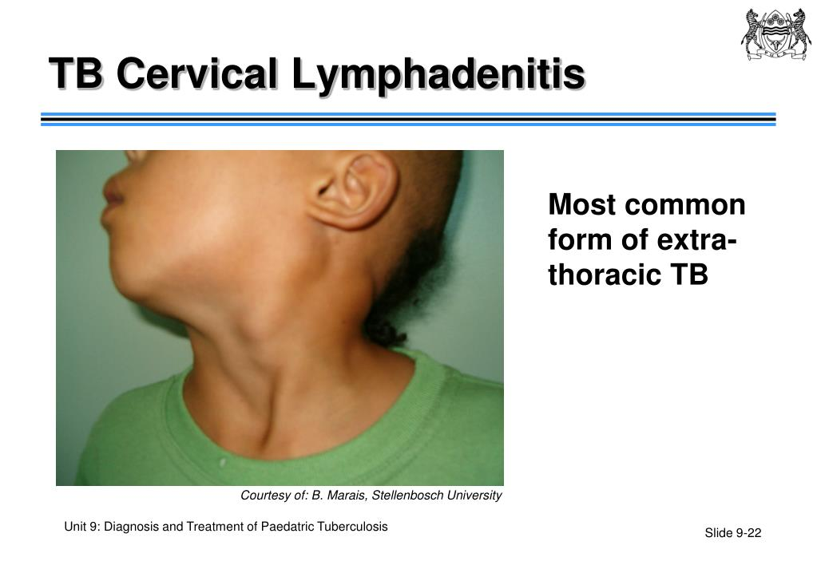
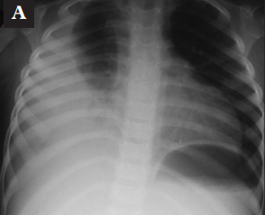
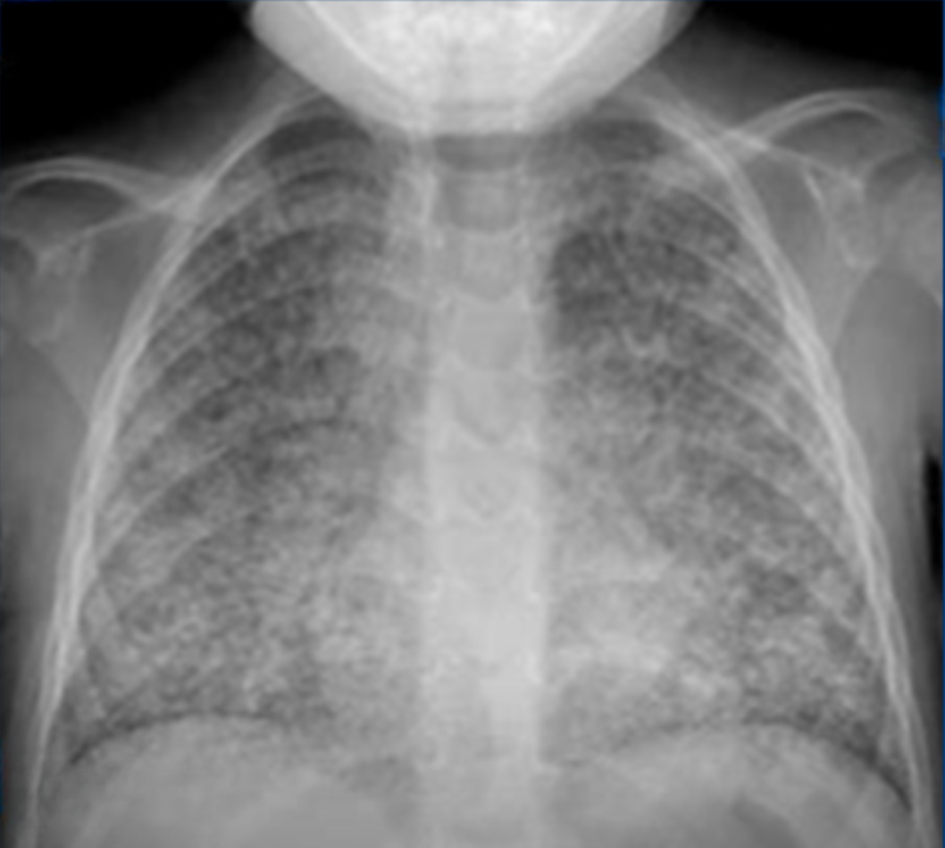
Presentation of EPTB in children and adolescents
Lymph node TB
Pleural TB
Miliary TB
Notes:
TB adenitis is asymmetrical, painless and non-tender and most commonly presents in cervical or neck lymph nodes. Lymph node enlargement is usually visible and persistent and may have a discharging sinus.
Pleural TB presents with dullness on percussion and reduced breath sounds and there is often non-severe chest pain.
TB meningitis presents as other forms of meningitis in children with headache, irritability/abnormal behaviour, vomiting (without diarrhoea), marked lethargy or reduced level of consciousness, and may have convulsions, neck stiffness, bulging fontanelle or cranial nerve palsies. Miliary TB is the other severe disseminated form of TB that may occur with meningitis but can also present with non-specific lethargy, fever and weight loss.

Slide 22
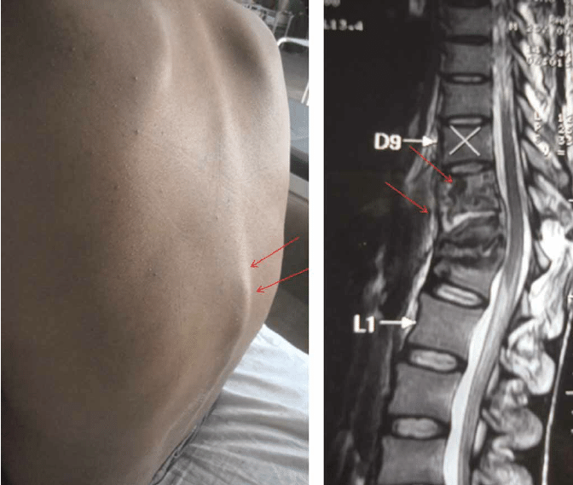
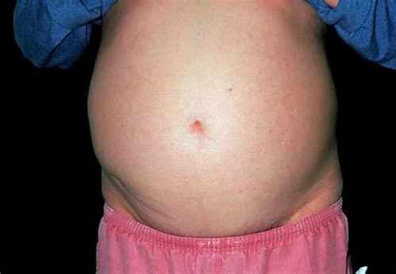
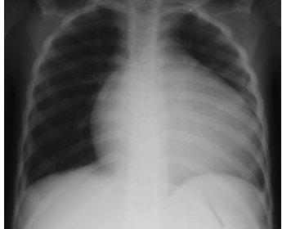
Presentation of EPTB in children and adolescents
Spinal TB
Abdominal TB
Pericardial TB
Notes:
Spinal TB typically presents late with deformity due to vertebral collapse and there may be lower limb weakness or paralysis due to spinal compression
Other bone or joint TB is usually at end of long bones - usually unilateral swelling of knee or hip with limitation of movement but not characterised by severe pain or tenderness as with septic arthritis.
Abdominal TB presents with abdominal pain, weight loss, abdominal swelling with ascites or abdominal masses, usually painless
Pericardial TB can present with chest pain and symptoms of cardiac failure
X-ray and ultrasound imaging are often useful for diagnosis and management.

Slide 23

Diagnosis of drug-resistant TB
The clinical presentation of drug-resistant TB in children and adolescent is similar to the presentation of drug-susceptible TB.
Bacteriological confirmation should always be sought but clinical diagnosis is also commonly required. Treatment of a child can be guided by the drug-susceptibility of a known contact with confirmed DR-TB.
Consider a diagnosis of drug-resistant TB if there is:
  Close contact with a person with known/confirmed DR TB
  Contact with a person with presumed drug-resistant TB such as did not respond to first-line treatment or is being retreated
  Unsatisfactory response to first-line TB treatment despite good adherence
  Previous treatment for TB and presents with recurrence of disease.
Notes:
The clinical presentation of MDR TB is similar to the presentation of drug-susceptible TB
Consider drug-resistant TB when there is close contact with a person with known/confirmed DR TB or with a person with presumed drug-resistant TB such as a person who did not respond to first-line treatment for TB or is being retreated;
Also consider if the child or adolescent patient is taking first-line TB treatment with good adherence and yet his not improving clinically with persistence of symptoms; or if was previously treated for TB and presents with recurrence of disease

Slide 24
Investigations

Slide 25
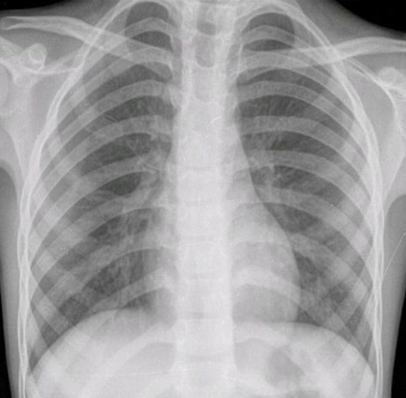
Investigations
Seek bacteriological confirmation whenever possible: consider availability, optimal sample, clinical indications and utility of the test.
Molecular WHO-approved rapid diagnostics increasingly available.
Xpert Ultra recommended for child TB on a range of samples.
Lack of access to TB diagnostic tests should not be a barrier to diagnosis or decision to treat in most cases.
A negative laboratory test does not rule out TB and CXR is commonly used to support TB diagnosis.
Notes:
All children and adolescents with presumptive TB ideally should undergo further evaluation for TB for bacteriological confirmation
There is variation in availability and access to TB diagnostic tests at different levels of care but molecular rapid diagnostics are increasingly available
In fact, Xpert Ultra is now the recommended rapid diagnostic test for children
As we know clinical diagnosis is often required, so a negative test or lack of access to TB diagnostic tests is not a barrier to the diagnosis of TB
CXR is often useful to support diagnosis but is not always available at primary care.

Slide 26
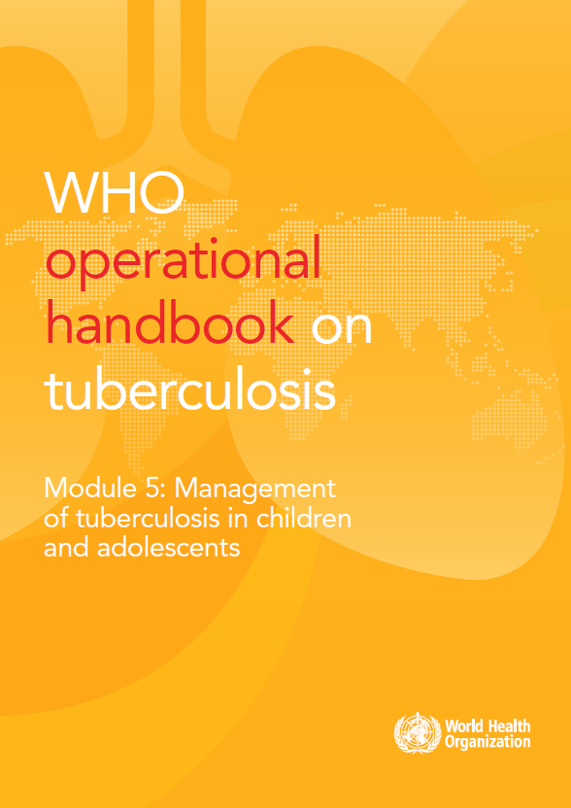
Use diagnostic tests whenever possible
Investigation | Type of sample | Rationale
Xpert MTB/RIF* Xpert MTB/RIF Ultra* | Sputum, expectorated or induced or swallowed e.g. GA, NPA, stool Lymph node aspirate Cerebrospinal fluid | Higher sensitivity and specificity compared to smear microscopy Detects rifampicin-resistant (or presumptive MDR) TB
LF-LAM | Urine to detect lipoarabinomannan | A bedside rule-in test for high-risk children and adolescents living with HIV especially with advanced disease or low CD4 < 200 cells/mm³
*WHO-recommended initial TB diagnostic tests
Note: smear microscopy may be used if Xpert unavailable.
This test is not preferred as it demonstrates low sensitivity (~7%) in children.
Notes:
Collect samples whenever possible to seek bacteriological confirmation using what rapid laboratory tests are readily available, preferably Xpert Ultra. If Xpert is not available, you can use smear microscopy. We need to keep in mind its low sensitivity in children.
An Xpert MTB/RIF or Ultra can be performed on sputum that is coughed up, expectorated or aspirated from the nasopharynx, or on sputum that is swallowed, from gastric aspirate or stool.
Samples from children and adolescents with some forms of EPTB that should also be routinely sent for Xpert include lymph node aspirate or CSF.
Other specimens such as pleural fluid, pericardial fluid, joint aspirate or ascites can be sent for investigation but are low yield.
Sampling is generally low risk though precautions to prevent infection are important when forceful coughing is induced such as induced sputum or nasopharyngeal aspiration.
The WHO operational handbook includes SOPs for procedures.

Slide 27
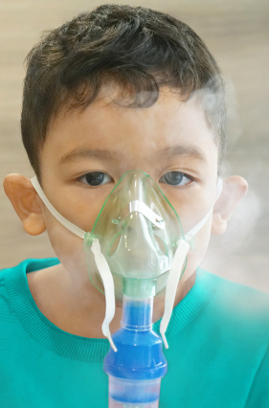
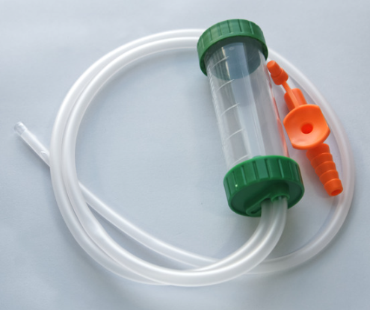
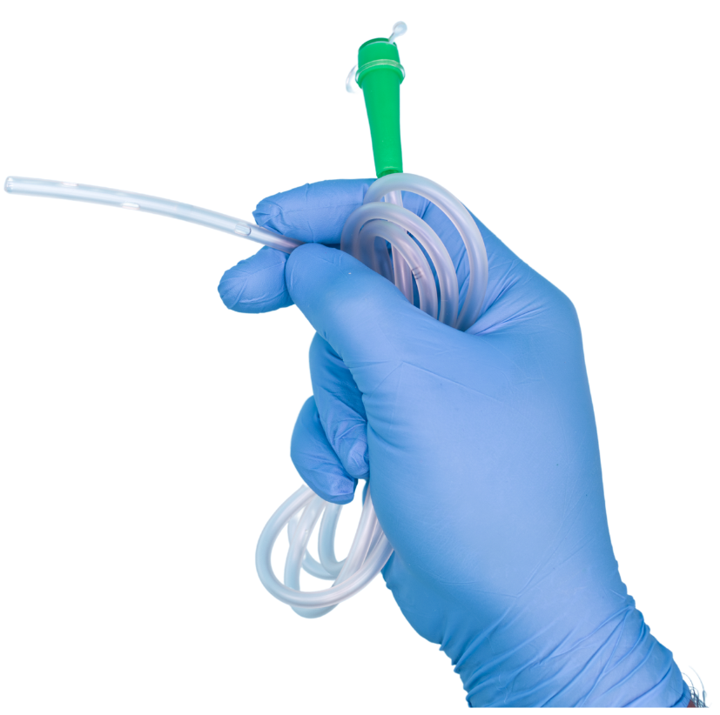
Alternative specimens
Induced sputum, with or without nasopharyngeal aspirate(NPA)
  Hypertonic saline solution (> 0.9%) nebulised to help loosen airway secretions.
  Young children may need nasopharyngeal aspiration after induction.
  Requires trained personnel, and electricity.
Caution: protective measures (masks) are important in the collection of specimens by invasive procedures that induce coughing.
Gastric aspirate
  Nasogastric tube (NGT) inserted to aspirate gastric contents

Slide 28
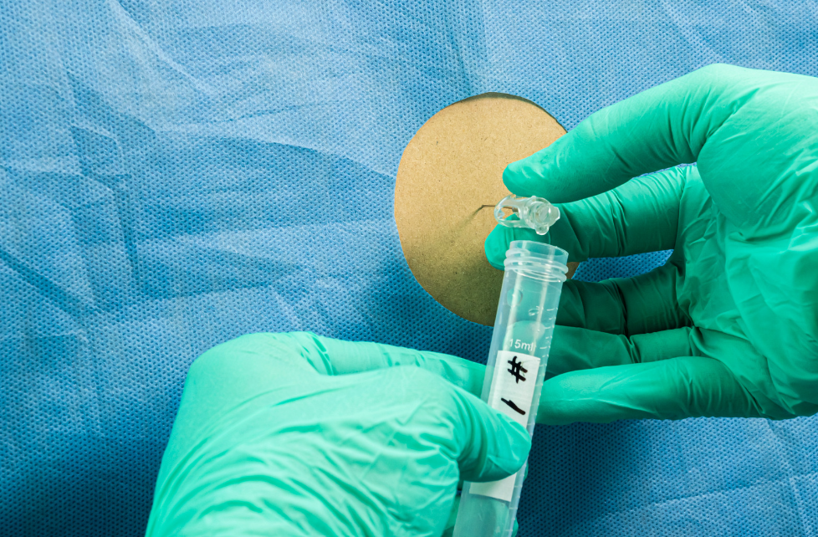
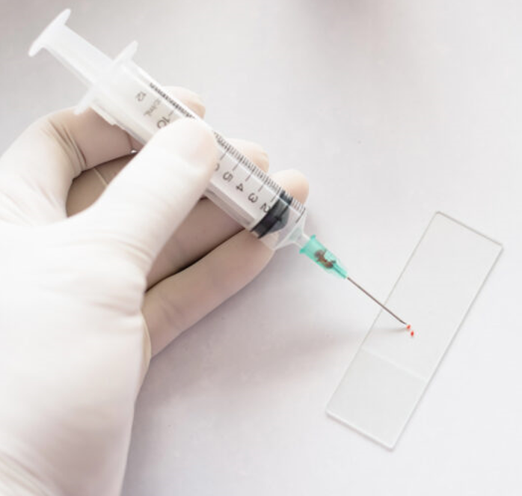
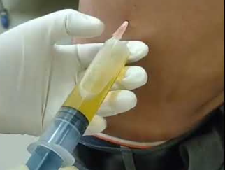
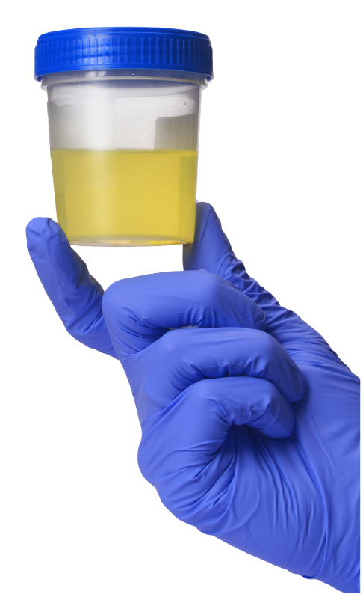
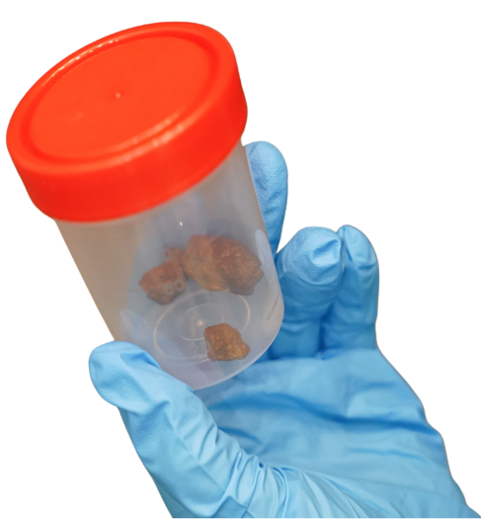
Alternative specimens
Specimens collected from sterile sites
  Body fluids and tissues: spinal fluid, pericardial, synovial, pleural or ascitic fluid, blood, bone marrow, lymph node aspirates etc.
Specimens collected from non-sterile sites
  Stool and urine

Slide 29
Collecting samples for bacteriological diagnosis
Consider the following when taking samples to optimise bacterial diagnostic yield:
Child’s ability to expectorate sputum
Most suitable option for your context
A standardised approach/SOP
Numbers – two samples better than one
Quality of sample – practice makes “perfect”
Determining whether drug-resistant TB
Notes:
Listed here are considerations for choosing a sampling technique to improve chance of bacteriological confirmation.
Many older children and adolescents, over 7 to 8 years of age, can usually provide a sputum sample by coughing it up as most adults do. If this is not possible, try to get sputum using the technique most suitable and practiced in your context. Induced sputum requires more equipment (such as nebuliser and suction pump) and training than gastric aspiration and yield from gastric aspiration can be similar or higher if the staff are familiar or have prior experience with the technique. Therefore, choose to do what you can and what staff are most able to do best. Stool is less invasive and sample can be collected at home but yield is not as high as gastric aspiration.
Whatever sampling method that you choose to do, take a standardised approach following standard operating procedures or SOPs and take two samples as higher chance of diagnostic confirmation than just one. There are SOPs published for all techniques, including in WHO operational handbook, so to have a printed one-page SOP available is very helpful. The quality of sample, and therefore yield, will improve with practice.
Sampling for laboratory testing should be considered in all children and adolescents with presumptive TB but is particularly important in those with presumptive drug-resistant TB. Quality of sample is again critical as results with low detection of MTB, such as trace result for Xpert Ultra, will not have sufficient microbial DNA to measure for resistance.

Slide 30
Proportionate yield for bacteriologically confirmed TB
Xpert Ultra is now recommended on a range of specimens.
A negative lab result does not rule out TB.
Most children require a clinical diagnosis.
Children
Adults
Kay AW, Ness T, Verkuijl SE, et al. Xpert MTB/RIF Ultra assay for tuberculosis disease and rifampicin resistance in children. Cochrane Database Syst Rev. 2022 Sep 6;9(9):CD013359. doi: 10.1002/14651858.CD013359.pub3. PMID: 36065889; PMCID: PMC9446385.
Notes:
Xpert is much more sensitive than smear microscopy in children and provides information on resistance if positive, but diagnostic yield is still much lower than in older adolescents and adults. Therefore, a negative test does not rule out active disease and clinical diagnosis is commonly required.
Xpert MTB/RIF and Ultra have high specificity but sensitivity or yield varies between samples: compared to culture, around 80% for lymph node aspirate, 60-70% for gastric aspirate, 50-60% for stool and around 40% for NPA.
Two samples from same or different sites are better than one.
Under programmatic conditions, the overall yield for bacteriological confirmation is only around 10-20%.

Slide 31
Other diagnostic tests in the evaluation for TB
Investigation | Eligibility (if available) | Rationale
HIV test | All with presumptive or diagnosed TB As per national guidelines | Risk for TB disease and severe disease Requires additional management (ART, CPT)
Test for infection TST or IGRA | Evidence of infection if no known contact Eligibility for TPT if contact and TB disease has been ruled out | Provides evidence of previous infection to support diagnosis TPT eligibility: not required if contact is young (<5 years) or living with HIV
Chest radiography (CXR) | If unable to produce sputum (collect an alternate sample), or If negative test result Decision to treat | Evidence of intrathoracic disease: hilar adenopathy, miliary picture, cavitation, effusion Evidence of severity of PTB
Ultrasound | If effusion suspected and to guide needle aspiration | Can define effusions that may be challenging to detect clinically such as pericardial or peritoneal or joint
Notes:
Establishing HIV status including a test for HIV if required should be routine in the assessment for TB. HIV is a risk factor for TB and if positive, additional treatments are required.
A test for infection can be useful if there is no known exposure. TST is more readily available and much cheaper than an IGRA test. Neither test is point-of-care so follow-up is required for a result. The other main challenge for both tests are that sensitivity is reduced in high-risk clinical TB cases such as HIV-infected, malnourished or with severe, disseminated TB. In otherwise well older child or adolescent contacts, both tests can be used to determine eligibility for TPT.
Chest X-ray is frequently indicated and used to examine for TB-related abnormalities – the commonest being enlarged hilar or mediastinal lymph nodes in children or cavities and parenchymal changes in adolescents. Chest X-ray is also the diagnostic of choice for miliary TB diagnosis as well as note pleural or pericardial effusions (with ultrasound). Ultrasound can identify ascites and abdominal lymphadenopathy associated with intestinal or peritoneal TB as well as joint effusions.

Slide 32
Chest X-ray
Notes:
Let’s have a look at a couple of the main abnormalities detected on CXR in children or adolescents with TB.
Note that The Union has recently developed a number of open access resources to support training and capacity in the interpretation of CXR abnormalities in children or adolescents, common abnormalities that are TB-related and abnormalities that define disease severity for treatment decisions.

Slide 33
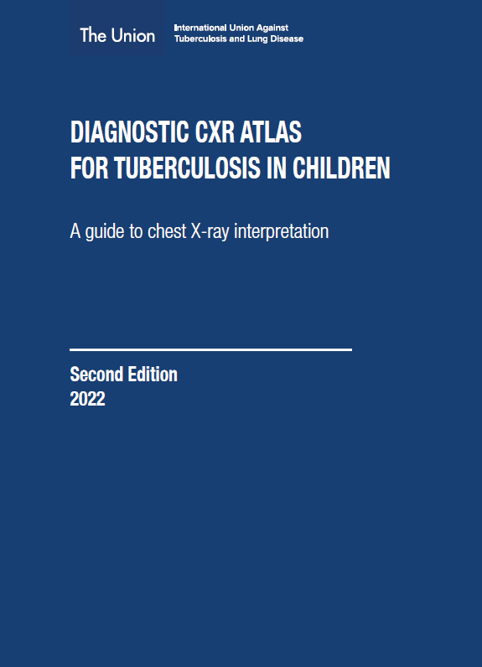
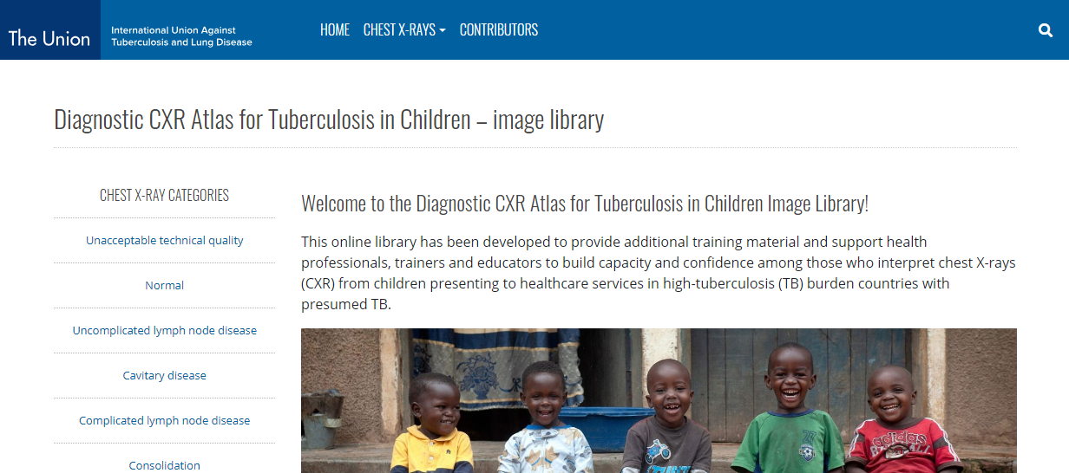
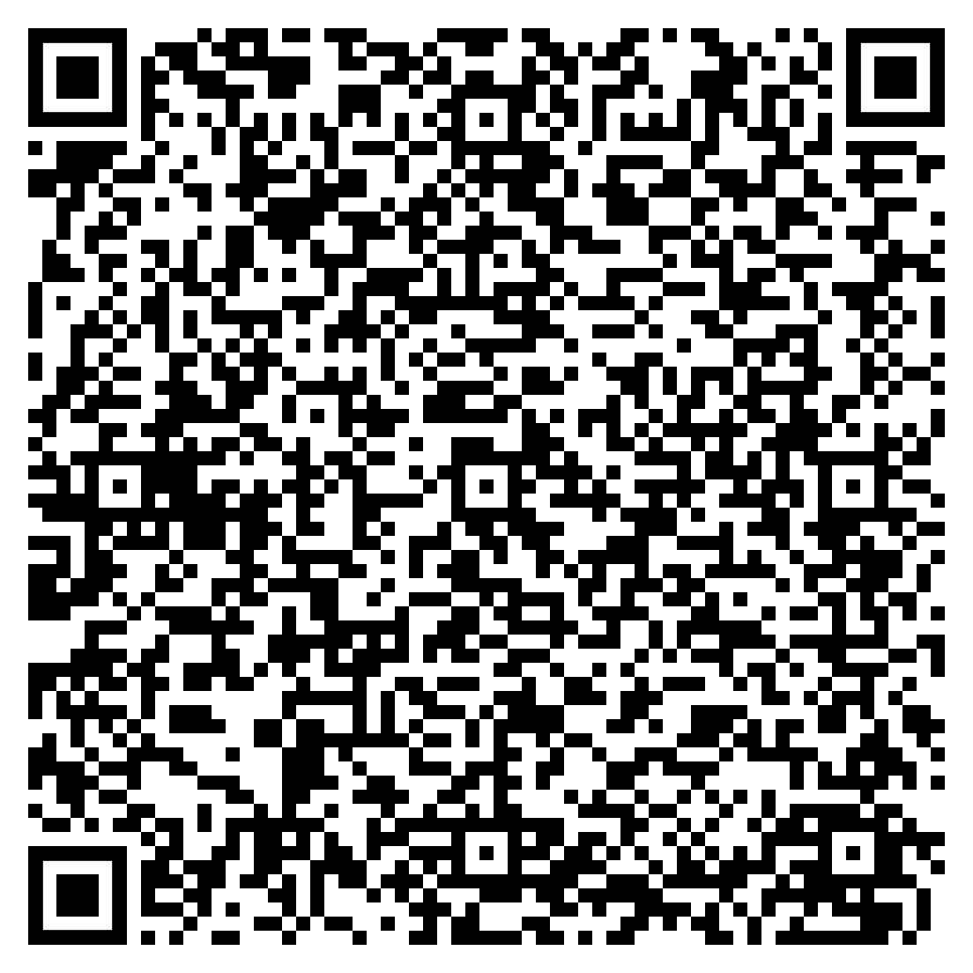

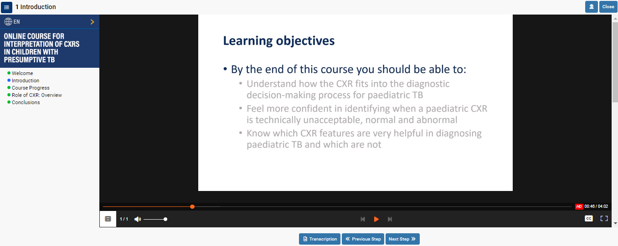
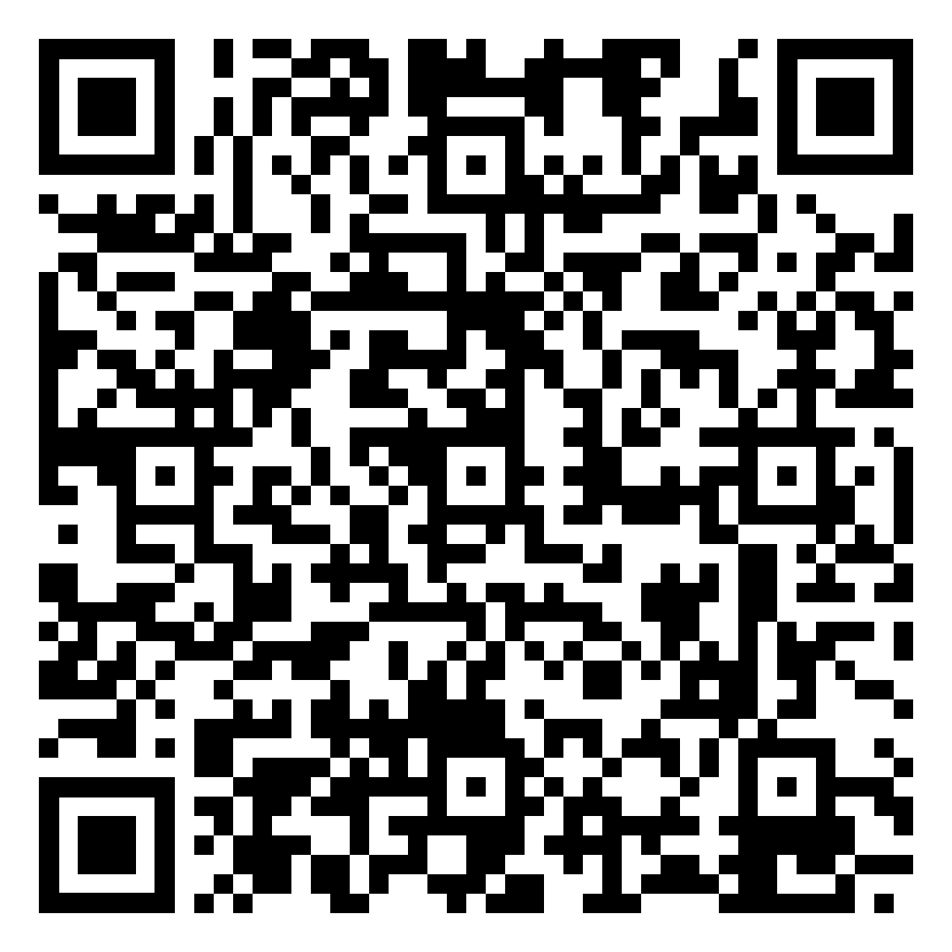
Interpretation of CXR in children with presumptive TB
Online course on interpretation of CXR in children with presumptive TB
The Union’s Online Diagnostic CXR atlas – image library
The Union’s Diagnostic CXR atlas
Notes:
The Union’s Diagnostic CXR atlas for tuberculosis in children with additional image available image library and the online training course on the interpretation of CXR provide examples of severe and non-severe TB as seen on CXR. This example would be classified as severe because the obvious lymph node enlargement is complicated by airway narrowing, which is not so obvious. This highlights the challenges as using CXR to determine severity requires good quality, inspiratory radiographs as well as some expertise or experience in interpreting abnormal findings. If in doubt, treat for 6 months.

Slide 34
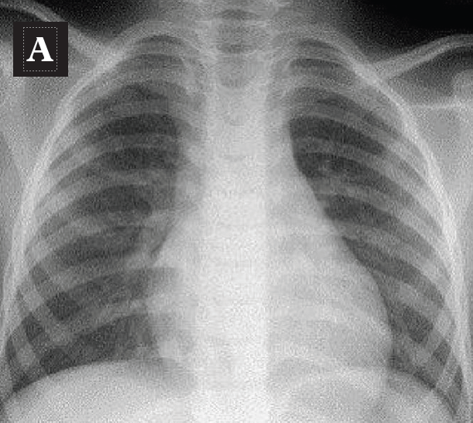
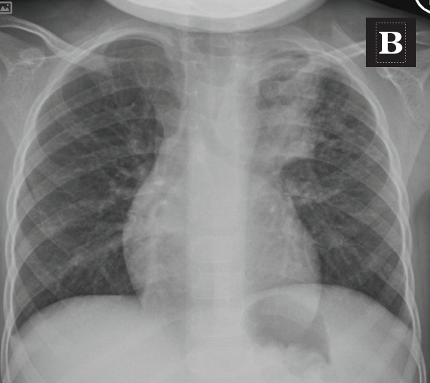
CXR features specific to TB – hilar adenopathy
Normal CXR
Enlarged paratracheal lymph node
Source: The Union. Diagnostic CXR atlas for tuberculosis in children. A guide to chest X-ray interpretation. 2nd ed. Paris, France. 2022. 94p.
Notes:
The commonest abnormality in children is lymph node enlargement and visibility of the enlargement is improved by also having a lateral CXR.
As for all CXR, the quality of the film is critical and it is optimal to have a good inspiratory film. The lymph node enlargement on the right on the CXR is quite obvious but often it is not so clear and needs to be distinguished from normal perihilar vascular markings or perihilar infiltration such as in viral respiratory infections.

Slide 35
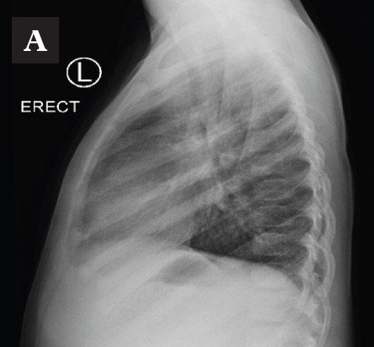
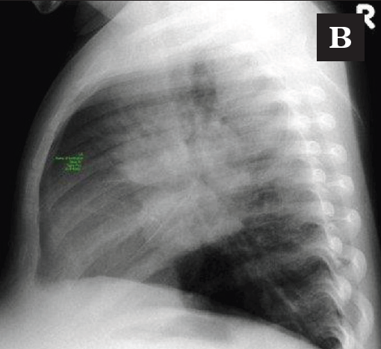
CXR features specific to TB – hilar adenopathy
Opacity in this posterior inferior quadrant is always abnormal
Normal lateral film
Abnormal lateral film with enlargement of the perihilar lymph nodes
Source: The Union. Diagnostic CXR atlas for tuberculosis in children. A guide to chest X-ray interpretation. 2nd ed. Paris, France. 2022. 94p.
Notes:
The commonest abnormality in children is lymph node enlargement and visibility of the enlargement is improved by also having a lateral CXR.
As for all CXR, the quality of the film is critical and it is optimal to have a good inspiratory film. The lymph node enlargement on the right on the CXR is quite obvious but often it is not so clear and needs to be distinguished from normal perihilar vascular markings or perihilar infiltration such as in viral respiratory infections.

Slide 36
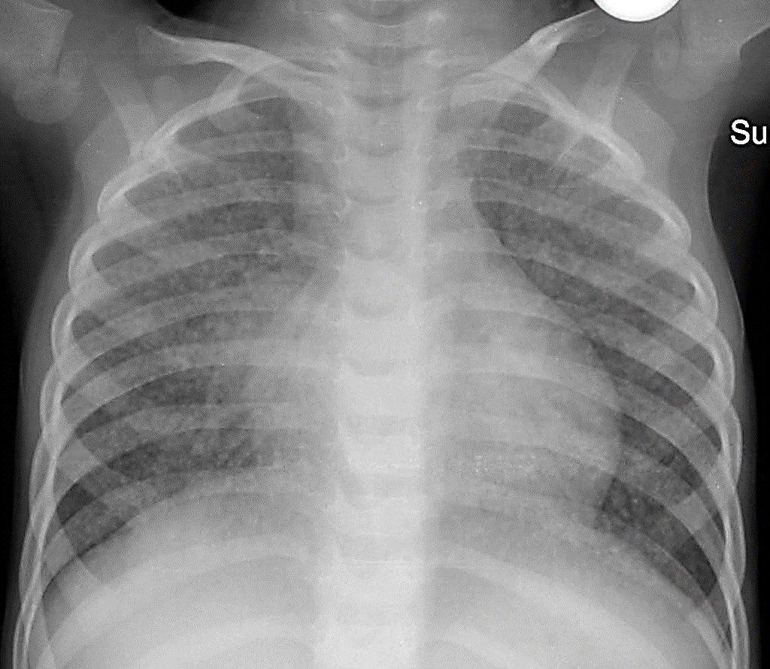
CXR features specific to TB – miliary picture
Fine nodules or small circles which look like grain or seed distributed throughout both lung fields
Notes:
This is a miliary picture or small seed-like opacities usually seen in throughout the lung fields. If you see a miliary picture, it is always due to disseminated TB and also consider spread elsewhere such as CNS TB.

Slide 37
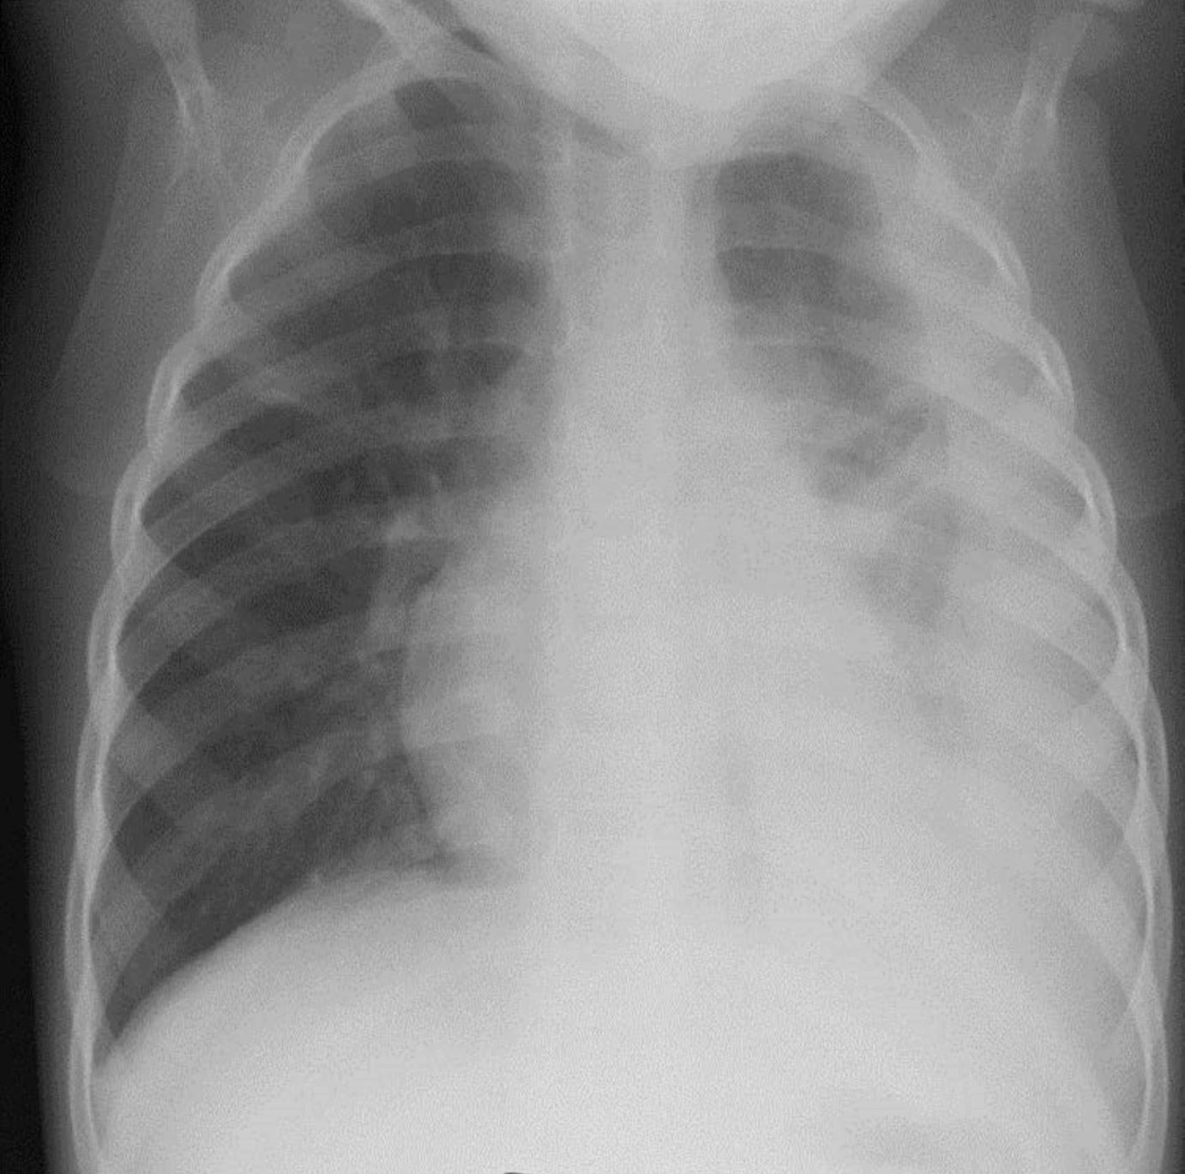
CXR features specific to TB - Pleural effusion
Simple left sided pleural effusion
Diagnostic CXR Atlas for Tuberculosis in Children – image library. Pleural effusion. https://atlaschild.theunion.org/241-2

Slide 38
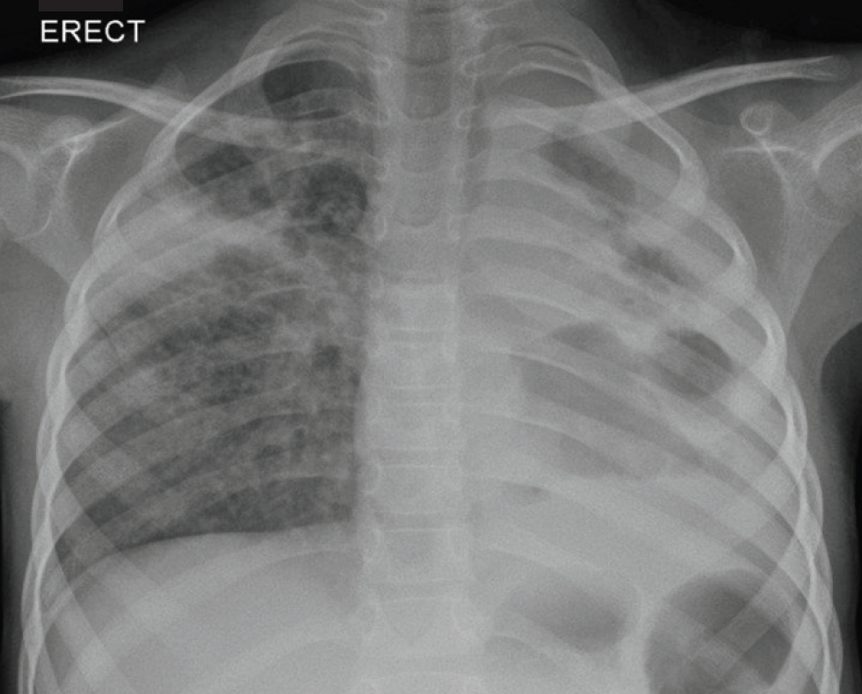
CXR features specific to TB – cavitation
Circular structures that are likely to be cavities
Patchy opacities throughout both lung fields
Cavities in right upper zone
Source: The Union. Diagnostic CXR atlas for tuberculosis in children. A guide to chest X-ray interpretation. 2nd ed. Paris, France. 2022. 94p.
Notes:
The adolescent with TB commonly presents with radiological changes similar to adults – such as with upper lobe cavities. Sputum collected will often be bacteriological positive.

Slide 39
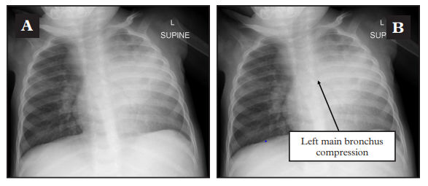
CXR – determining severity for treatment duration
CXR abnormalities may also be important in determining severity to inform treatment decisions, as discussed further in Module 3.
  In addition to short regimen for DS TB, it is also relevant for choosing 9 vs 12 months for MDR/RR-TB.
Left main bronchus compression
Source: The Union. Diagnostic CXR atlas for tuberculosis in children. A guide to chest X-ray interpretation. 2nd ed. Paris, France. 2022. 94p.
Notes:
It is helpful to distinguish pulmonary TB as severe or non-severe at diagnosis as it may determine duration of treatment regimen.
Features of severe pulmonary TB seen here are parenchymal disease extending beyond on lobe and compression of an airway from enlarged lymph node.

Slide 40
Treatment decision approaches
Notes:
Management or treatment decision approaches are useful to support healthcare workers provide appropriate care for a child or adolescents with presumptive TB.

Slide 41

Approach to diagnosis and treatment decision
Important questions in the assessment include:
Does the child or adolescent require immediate inpatient care?
Are the symptoms TB-related and is there a known contact history?
Is the child at risk for severe TB disease?
What samples and tests are available for diagnosis?
What treatment regimen is indicated based on disease site, severity, drug-susceptibility?
Notes:
Treatment decision algorithms use similar overall approaches to evaluation and management decisions that include:
Triage for severity of illness that may require immediate management;
Determine presence of TB-related symptoms and contact history;
Careful examination including of nutritional status;
Risk evaluation for TB disease on basis of age and comorbidities such as HIV or severe malnutrition;
Results of bacteriological tests
Chest X-ray findings.
Assessment of disease site, severity and drug susceptibility
Note that it is not always critical to make a decision to treat for TB at first presentation; sometimes follow-up of children to re-evaluate symptom and weight can be very helpful.

Slide 42
Indications for referral
Presence of danger signs requiring urgent medical care
  Signs of severe respiratory distress
  Signs of CNS disease
  Presumptive meningitis or invasive sepsis
Diagnostic uncertainty requiring further investigation
  Invasive procedure required for laboratory sample
  Presumptive drug-resistant TB
Management of comorbidities
  Initiation of ART and comprehensive HIV care
  Severe malnutrition for nutritional rehabilitation
  Other comorbidities such as severe anaemia
Notes:
It is also important to decide if referral to higher level of care is required. This may be required if the child or adolescent is severely ill with danger signs such as with severe pneumonia or respiratory distress, signs suggesting CNS disease such as reduced level of consciousness or recurrent/prolonged seizures or differential diagnosis includes meningitis or sepsis. Treatment should be initiated without delay such as awaiting transport for referral.
A second reason for referral may be that other diagnostic approaches are required that are not available at a peripheral level of care, and that diagnostic certainty would benefit from procedures that cannot be performed in current setting such as pleural tap or lumbar puncture, or that the child and adolescent has presumptive drug-resistant TB requiring further assessment or treatment initiation that is not available at the primary care level.
A third reason may be the management of comorbidities such as for HIV care, severe malnutrition or severe anaemia

Slide 43
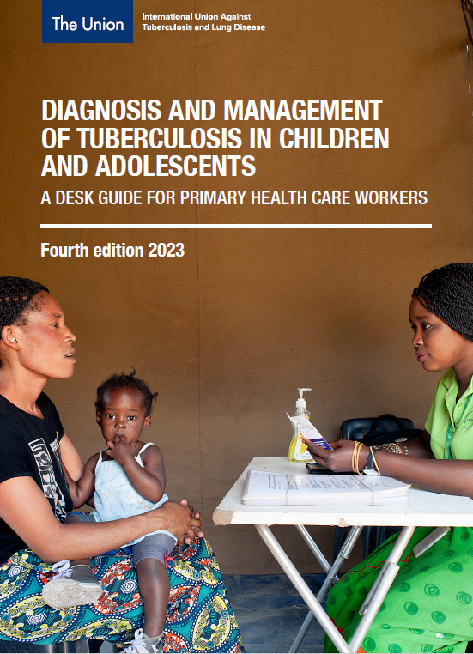
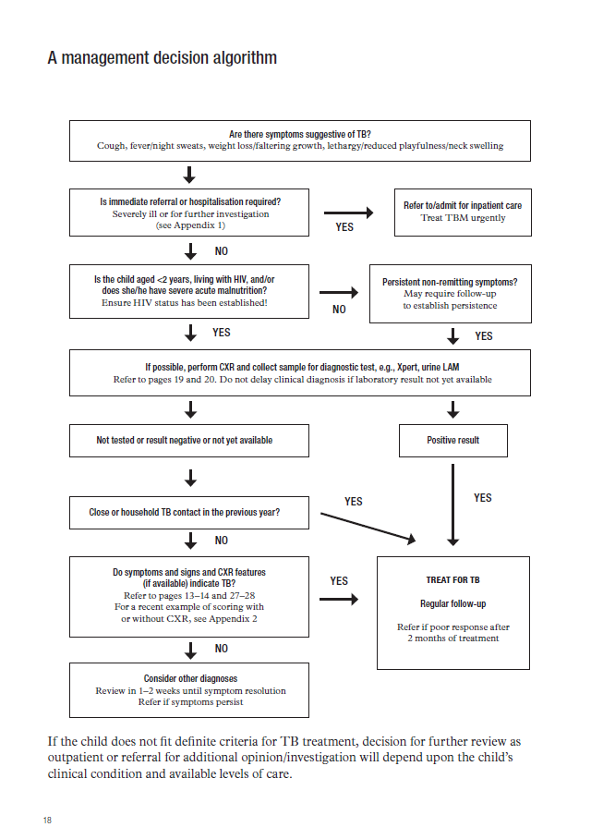
Example: management approach for child with presumptive TB
Notes:
There is a number of management decision approaches available and there may be one in use and available in your own setting. The slide shows an example of the approach in the Union’s Desk guide.

Slide 44
Notes:
There is a number of management decision approaches available and there may be one in use and available in your own setting. The slide shows an example of the approach in the Union’s Desk guide.

Slide 45
Notes:
There is a number of management decision approaches available and there may be one in use and available in your own setting. The slide shows an example of the approach in the Union’s Desk guide.

Slide 46
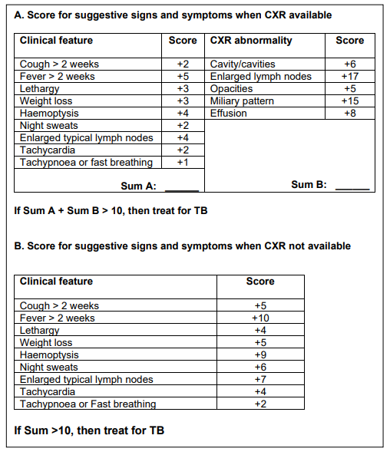
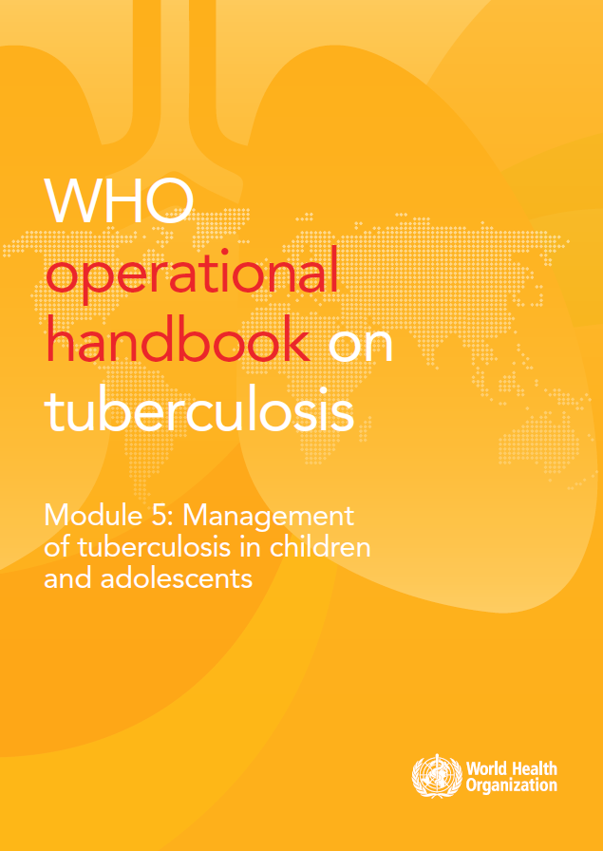
Diagnostic score systems
Treatment decision approaches have been developed and evaluated.
An example for use with or without CXR.
This approach with score system prioritises sensitivity over specificity.
Limited to use in children
< 10 years old
Gunasekera KS, Marcy O, Muñoz J, et al. Development of treatment-decision algorithms for children evaluated for pulmonary tuberculosis: an individual participant data meta-analysis. Lancet Child Adolesc Health. 2023 May;7(5):336-346. doi: 10.1016/S2352-4642(23)00004-4. Epub 2023 Mar 13. PMID: 36924781; PMCID: PMC10127218.
Notes:
Treatment decision approaches have been developed in many settings such as scoring systems widely in use in PNG, Indonesia or Brazil. The approaches have not been well validated. The score on the right was developed using data from over 4000 children with TB and is included in a suggested treatment decision algorithm published in the WHO operational handbook in 2022 – now being further validated. These systems prioritise sensitivity over specificity which means aiming to miss as few cases as possible while accepting that there will be over-diagnosis and over-treatment

Slide 47
Discussion – setting specific practices

Slide 48
Discussion: setting specific practices
What steps might you take in your practice setting to improve the clinical and bacteriological diagnosis of TB in children?
1
When do you use chest radiography for TB diagnosis, and what are the challenges or limitations?
2
What factors, advantages and disadvantages do you consider in a decision to refer to child with presumptive TB to a higher level of care?
3

Slide 49
What steps might you take in your practice setting to improve the clinical and bacteriological diagnosis of TB in children?
1
When do you use chest radiography for TB diagnosis, and what are the challenges or limitations?
2
What factors, advantages and disadvantages do you consider in a decision to refer to child with presumptive TB to a higher level of care?
3

Slide 50
Conclusion
Summary of key points

Slide 51
Summary of key learning points
Diagnosis of TB in children and adolescents is not always difficult.
Bacteriological confirmation should always be sought but clinical diagnosis with support of imaging is commonly required.
Approach depends on age, site of disease, severity and comorbidities.
The approach to diagnosis of drug-resistant TB is similar to that for drug-susceptible TB with particular attention to determining recent exposure.
Useful to have diagnostic algorithm or treatment decision approach to support the healthcare worker.
Most TB can be diagnosed at all levels of care but there are clinical indications or diagnostic considerations that may require referral.
Notes:
Diagnosis of TB in children and adolescents is not always difficult
Bacteriological confirmation should always be sought but clinical diagnosis with support of imaging is commonly required
Approach depends on age, site of disease, severity and comorbidities
The approach to diagnosis of drug-resistant TB is similar to that for drug-susceptible TB with particular attention to determining any recent exposure to someone with drug-resistant TB
Useful to have a diagnostic algorithm or treatment decision approach to support the healthcare worker
Most TB can be diagnosed at all levels of care but there are clinical indications or diagnostic considerations that require referral

Slide 52
References
Clinical standards for drug-susceptible TB in children and adolescents. Chiang SS, Graham SM, Schaaf HS, et al. Int J Tuberc Lung Dis 2023; 27: 584-598
WHO operational handbook on tuberculosis. Module 5: Management of tuberculosis in children and adolescents. Geneva, Switzerland: World Health Organization 2022.
Diagnosis and management of tuberculosis in children and adolescents. A desk guide for primary health care workers. Fourth edition 2023. The Union, Paris, France, 2023.
Diagnostic CXR atlas for tuberculosis in children. A guide to chest X-ray interpretation. The Union, France, 2022.
Xpert MTB/RIF Ultra assay for tuberculosis disease and rifampicin resistance in children. Kay AW, et al. Cochrane Database Syst Rev 2022;9:CD013359
Gunasekera KS, Marcy O, Muñoz J, et al. Development of treatment-decision algorithms for children evaluated for pulmonary tuberculosis: an individual participant data meta-analysis. Lancet Child Adolesc Health. 2023 May;7(5):336-346. doi: 10.1016/S2352-4642(23)00004-4. Epub 2023 Mar 13. PMID: 36924781; PMCID: PMC10127218.

Slide 53
Challenge your knowledge

Slide 54
Quiz question 1
Regarding the screening and diagnosis of TB in children and adolescents, which of the following statements is FALSE?
Screening for TB should be routinely included in the evaluation of sick children and adolescents.
In both children and adolescents, recent contact with a patient diagnosed with TB should trigger an evaluation for TB.
Both children and adolescents with pulmonary TB have similar presentations on chest x-ray.
Children often have paucibacillary disease and a clinical diagnosis is often required.

Slide 55
Quiz question 1 - answer
Regarding the screening and diagnosis of TB in children and adolescents, which of the following statements is FALSE?
Screening for TB should be routinely included in the evaluation of sick children and adolescents.
In both children and adolescents, recent contact with a patient diagnosed with TB should trigger an evaluation for TB.
Both children and adolescents with pulmonary TB have similar presentations on chest x-ray.
Children often have paucibacillary disease and a clinical diagnosis is often required.

Slide 56
Quiz question 2
Regarding the diagnosis of TB in children and adolescents, which of the following statements is FALSE?
Bacteriological confirmation should be sought whenever possible. However, a negative test does not rule out TB.
Alternative sample specimen e.g., stool, urine or lymph node aspirates can be used for Xpert testing if sputum is not available.
Urine LAM is an alternative test that can be used to detect TB in all sick children and adolescents.
Other diagnostic tests e.g., HIV test, TB skin test, IGRA and ultrasound scans can be used to support the diagnosis of TB in children.

Slide 57
Quiz question 2 – answer
Regarding the diagnosis of TB in children and adolescents, which of the following statements is FALSE?
Bacteriological confirmation should be sought whenever possible. However, a negative test does not rule out TB.
Alternative sample specimen e.g., stool, urine or lymph node aspirates can be used for Xpert testing if sputum is not available.
Urine LAM is an alternative test that can be used to detect TB in all sick children and adolescents.
Other diagnostic tests e.g., HIV test, TB skin test, IGRA and ultrasound scans can be used to support the diagnosis of TB in children.

Slide 58


